Slide 1


EPROJECT SEM 2
APTECH
PRESENT
MOVIE TICKET
Group 1
Nguyễn Hùng Anh – C2009G0054
Ngô Minh Hiếu – C2009G0040
Nguyễn Quốc Bảo – C2009G0052

Slide 2






Topic:
Build an application to simulate movie ticket booking for cinemas. This application is as follows:
+ Class Server: generates multiple movie titles along with movie information and maintains it to allow the client to perform transactions.
+ Class Client: is a program that allows customers to watch movies, book tickets, buy tickets, pay tickets on demand.

Slide 3
Content
Reasons for choosing the topic
Theoretical basis
System description
System Diagram
Demo
Conclusion and development direction

Slide 4
1. Reason for choosing the topic
In today’s cinemas, the management and organization of movie screenings and ticket sales is always a matter of concern. The manager always faces difficulties in the operation of each department such as movie, schedule and equipment, and especially the ticketing process. When you want to buy movie tickets, buyers have to go to the theater, wait in line, see if there are still tickets, if there are good seats, if there is a movie they like or not, etc…, which is very passive and annoying and time consuming time.
For that reason, creating a movie ticket management software is esssential.

Slide 5
1. Reason for choosing the topic
The movie ticketing management system is built based on the actual needs of customers and managers in order to solve difficulties encountered and reduce many risks in the process of theater management
The system is aimed at customers and the management staff in the theater. The main function is to manage the booking of movie tickets for cinemas, making it easy for the manger to control the operation of the theater and convenient for customers to buy tickets.

Slide 6
2. Theoretical basis
JAVA
JAVA: is an object-oriented and class-based programming language
General features of OOP:
Abstract
Polymorphism
Inheritance
Encapsulation

Slide 7
2. Theoretical basis
JAVA
Java also has other features:
Independent background
Simple
Security
Multi-threaded
High performance
Flexible

Slide 8
2. Theoretical basis
LIBRARY
JDateChooser
JTimePicker
And more…
MySQL

Slide 9
3. Description of the system
Identify the actors that use the site as follows:
Admin: The system manager, including management of screening rooms, seats, movies, movie schedules, users, employee, revenue…
Customer: The person who uses the software to book movie tickets.
Based on the above two factors, our website consists of 3 main modules:
1 module for admin, 1 module for employees, 1 module for customers.

Slide 10
3. Description of the system
Module for admin:
Display a list of movies.
Display a list of schedules by movie.
Display a list of users.
Display a list of employees.
Display a list of tickets.
Order tickets.
Display revenue.

Slide 11
3. Description of the system
Module for employee:
Display a list of movies.
Display a list of schedules by movie.
Display a list of users.
Display a list of tickets.
Order tickets.

Slide 12
3. Description of the system
Module for customers:
View movie information and select a movie.
Select schedule.
Choose a seat.
Book movie tickets and view booked tickets.
Personal information management.

Slide 13
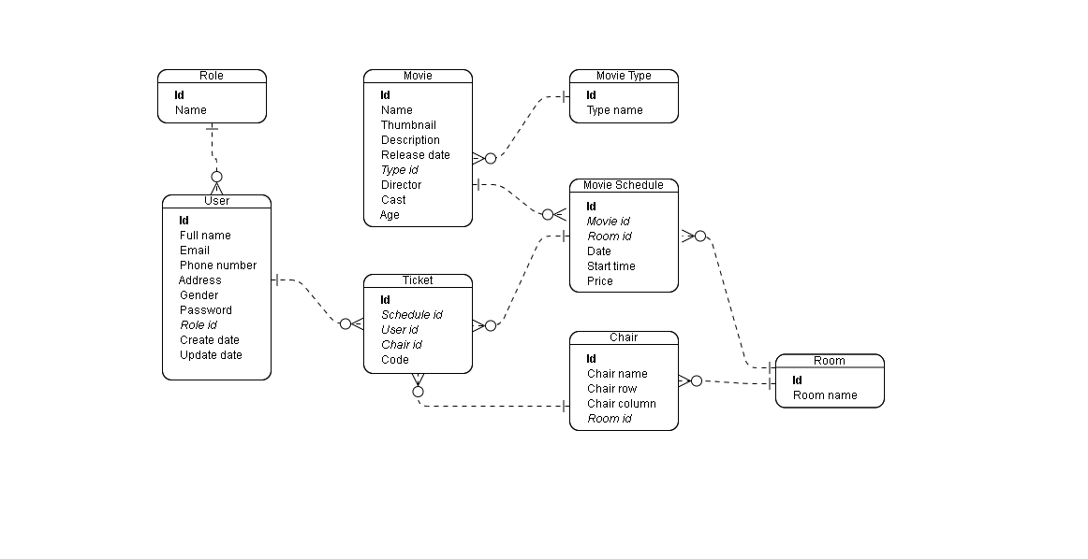
4.1 ERD Diagram

Slide 14
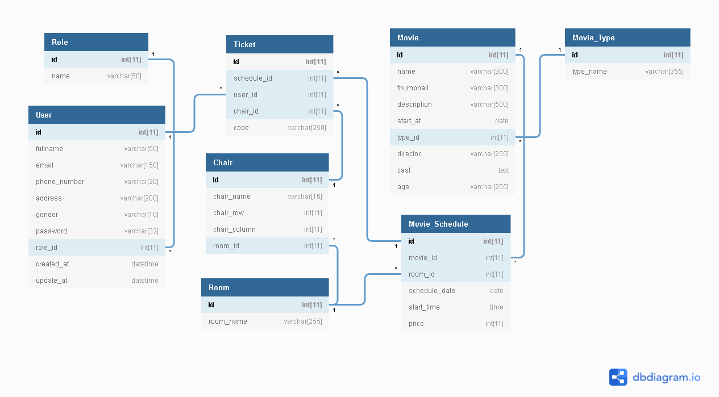
4.1 Database Diagram

Slide 15



5. DEMO

Slide 16

6. Conclusion and development direction
4.1. Conclude
4.1.1. Reach
Basically, the project has completed the most important and necessary functions in the project.
Complete software with functions required by users.

Slide 17
6. Conclusion and development direction
4.1.2. Restriction
Besides the advantages that have been achieved, there are also some limitations that we face. Due to the limited amount of knowledge and limited time to implement the topic, we could not achieve the set goal to the maximum, the following are our limitations:
The interface is not beautiful yet.
The functions are still limited, have not really created many functions to be more suitable for users.
The system model has not been optimized much.

Slide 18
6. Conclusion and development direction
4.1.3. Development
Continue to learn to improve as well as hone your knowledge to build larger-scale applications.
Efforts to perfect the application and be able to commercialize.

Slide 19


Thanks you for listening

